Slide 1
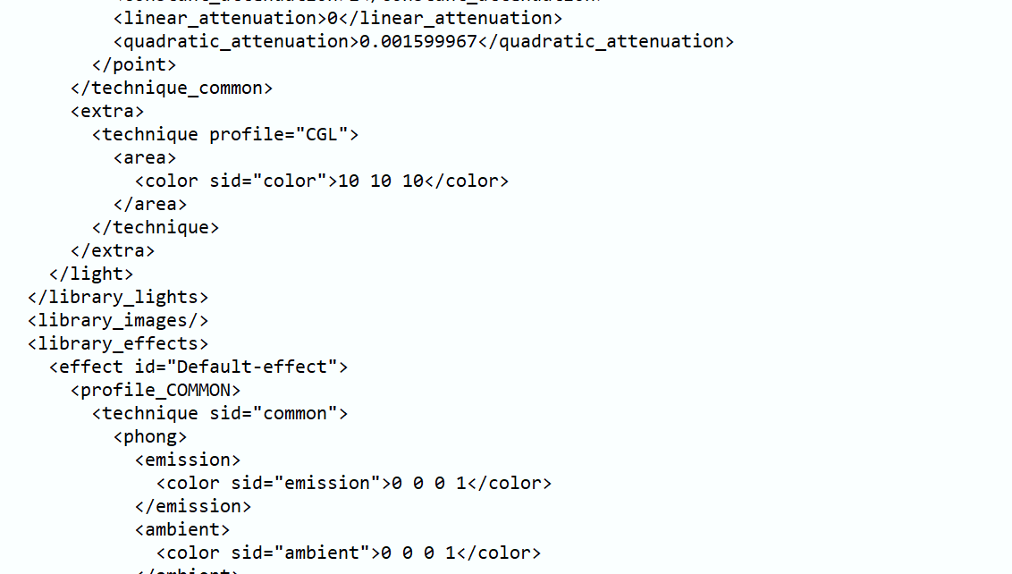
Final Project: Texture Mapping for Pathtracer
Eden Lin
Summer 2020

Slide 2
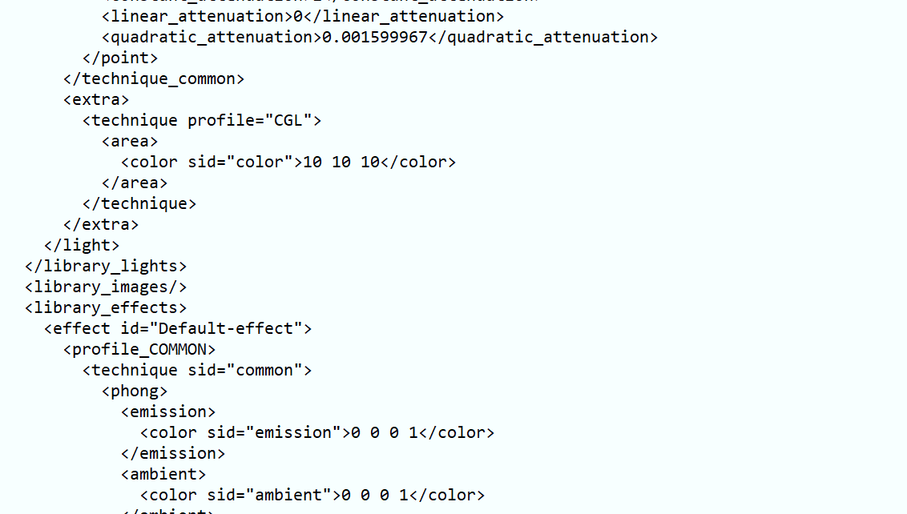
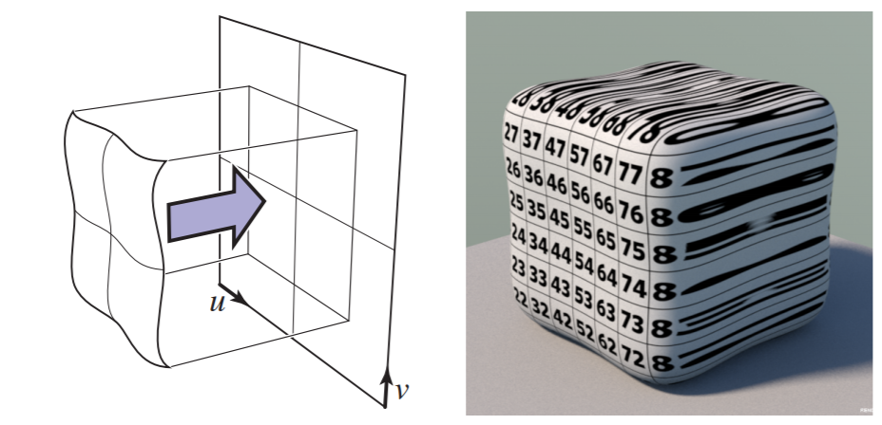
Texture mapping methods
Planar projection
s = u, t = v

Slide 3
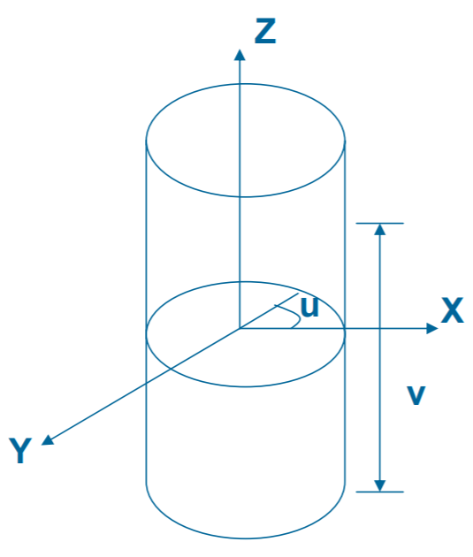
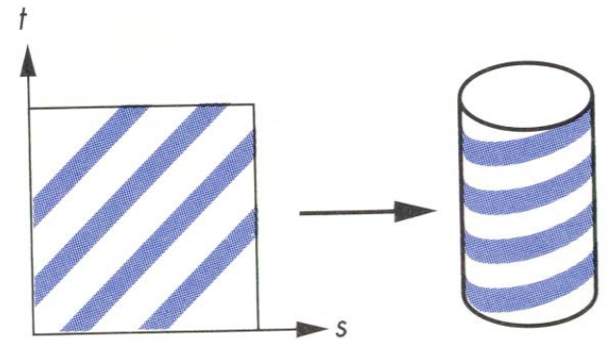

Texture mapping methods
Cylindrical projection
u = arctan(y/x), v = z
s = ($π$ + u) / 2$π$, t = v

Slide 4
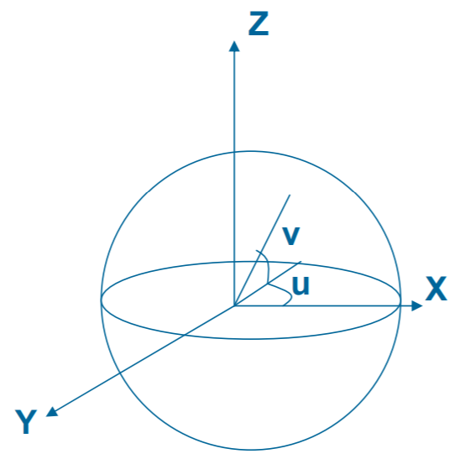

Texture mapping methods
Spherical projection
u = arctan(y/x), v = arctan($\sqrt{x^{2}+y^{2}}/z$)
s = (u + $π$/2) / $π$, t = (v + $π$) / 2$π$

Slide 5

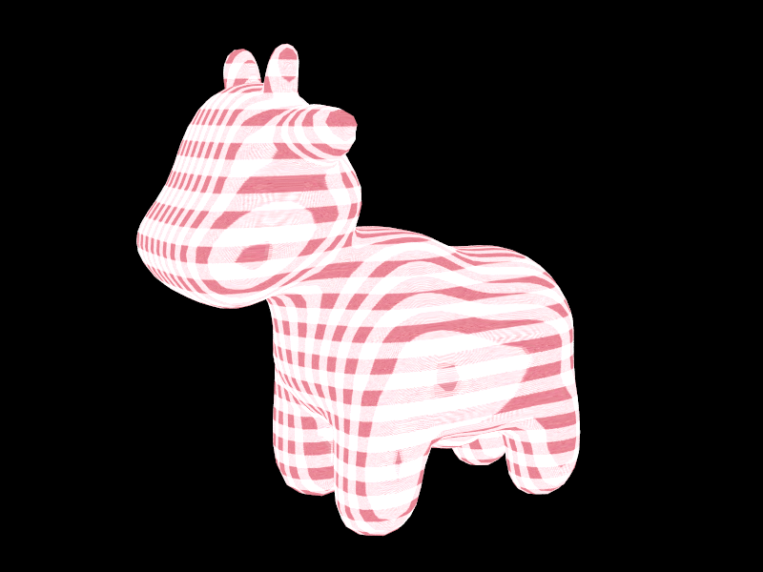
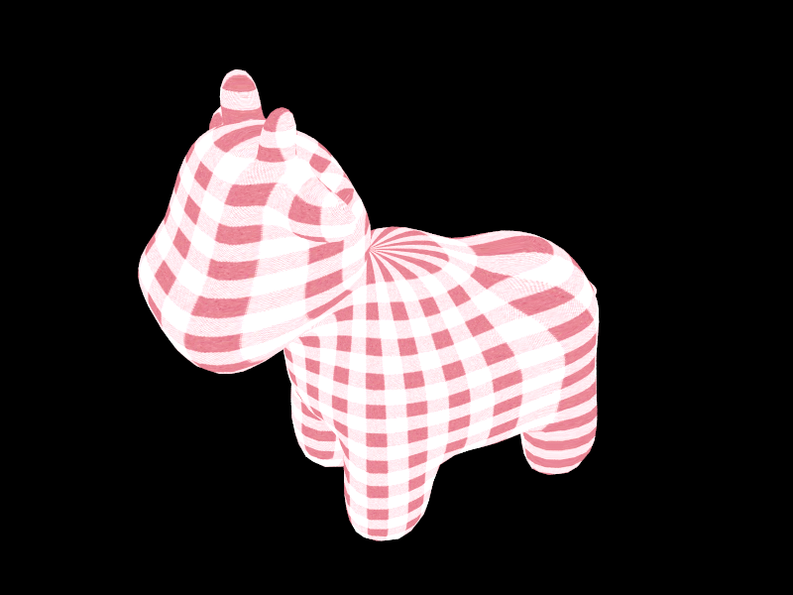
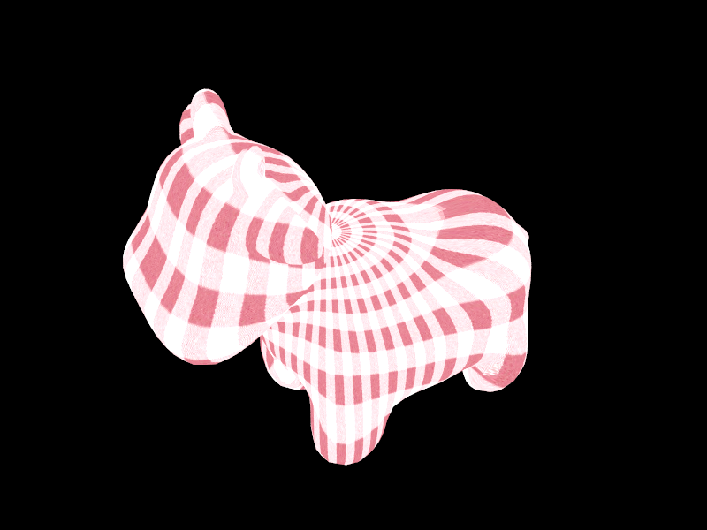
Projection results
Planar
Cylindrical
Spherical

Slide 6
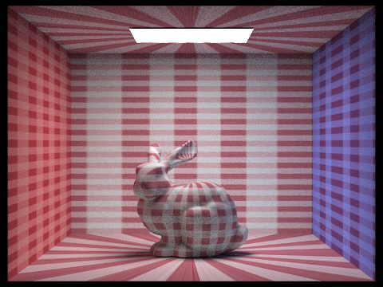
Background mapping

Slide 7
Parsing COLLADA
collada.cpp: type
emission, mirror, etc.
“name”
leftWall, ceiling, floor, etc.

Slide 8
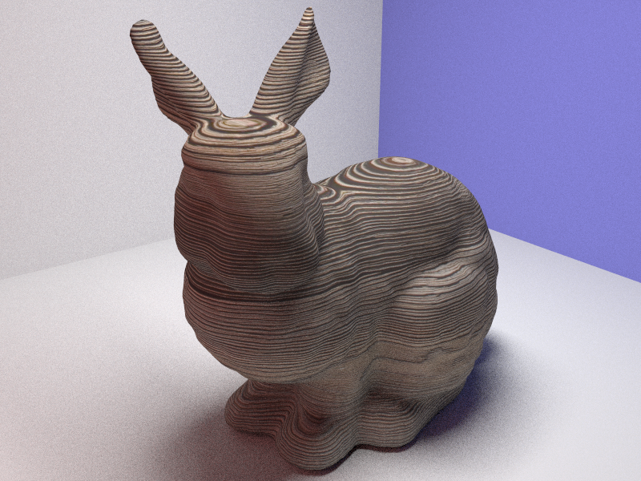
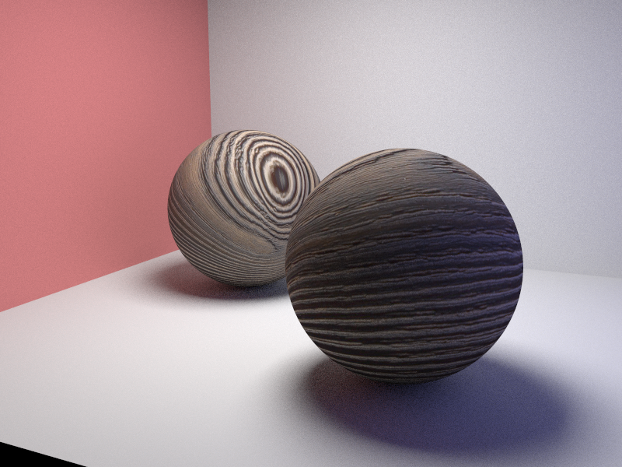
Results

